Slide 1
UNDERSTANDING THE 7 TYPES OF PLASTICS IN FOOD PACKAGING

Slide 2
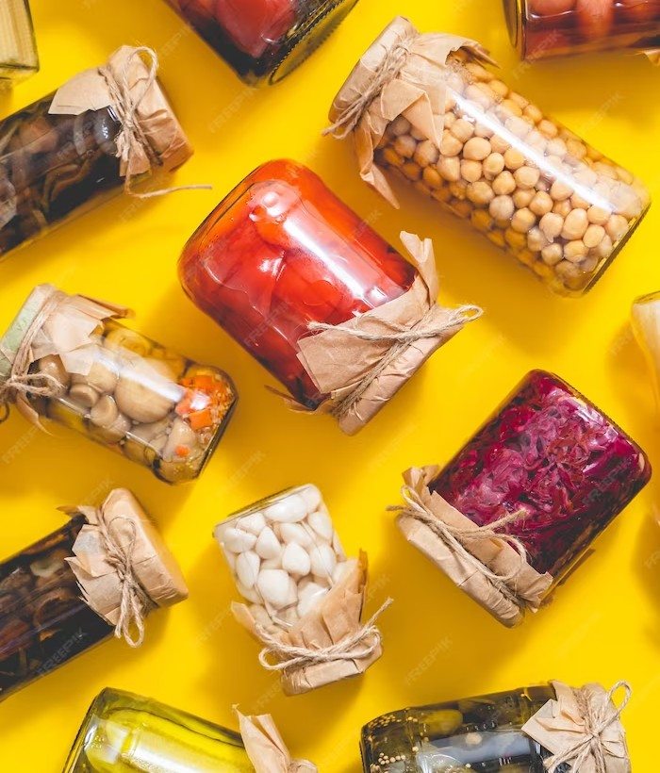
INTRODUCTION
Plastics play a crucial role in packaging, but it's important to understand their impact on food safety and the environment. In this presentation, we will explore the different types of plastics commonly used in food packaging and their properties.

Slide 3
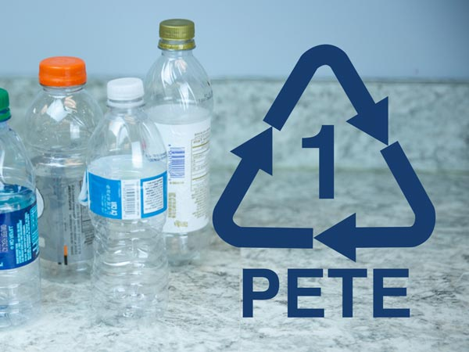
TYPE 1: PET (POLYETHYLENE TEREPHTHALATE)
PET is commonly used for water bottles and soda bottles. It is lightweight, transparent, and has good gas barrier properties. However, it can leach chemicals like antimony into food and is not suitable for hot liquids or microwave use.

Slide 4
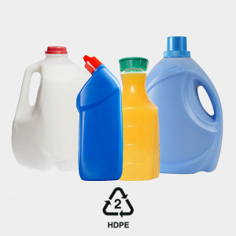
TYPE 2: HDPE (HIGH-DENSITY POLYETHYLENE)
HDPE is used for milk jugs, detergent bottles, and grocery bags. It is resistant to impact, moisture, and chemicals.
HDPE is considered safe for food packaging as it does not leach harmful substances into food.

Slide 5
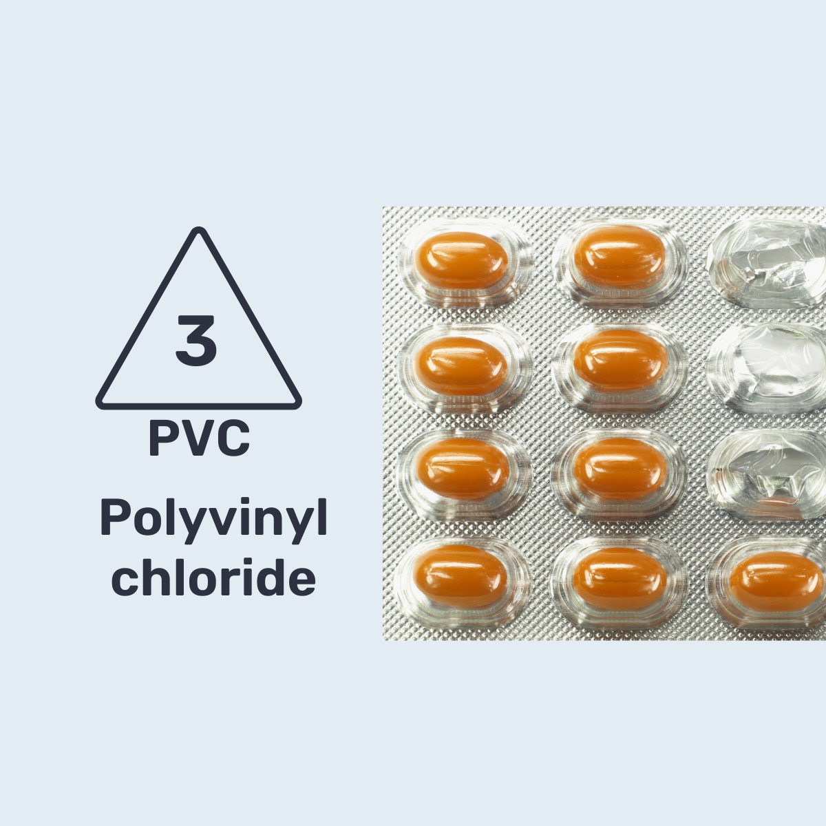
TYPE 3: PVC (POLYVINYL CHLORIDE)
PVC is used for cling wrap, blister packaging, and some bottles. It is ﬂexible and has good clarity. However, PVC contains phthalates which can migrate into food and have been linked to health issues. It is not recommended for food packaging.

Slide 6
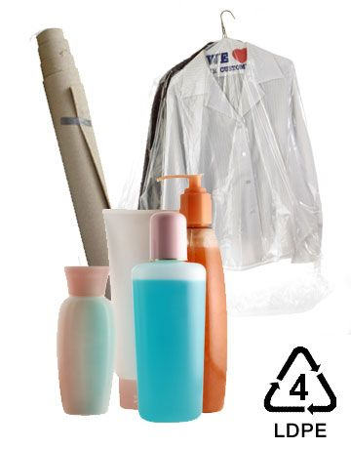
TYPE 4: LDPE (LOW-DENSITY POLYETHYLENE)
LDPE is used for squeezable bottles, bread bags, and food wraps. It is ﬂexible and has good heat resistance. LDPE is generally considered safe for food packaging, but it may not provide strong barrier properties against oxygen and moisture.

Slide 7
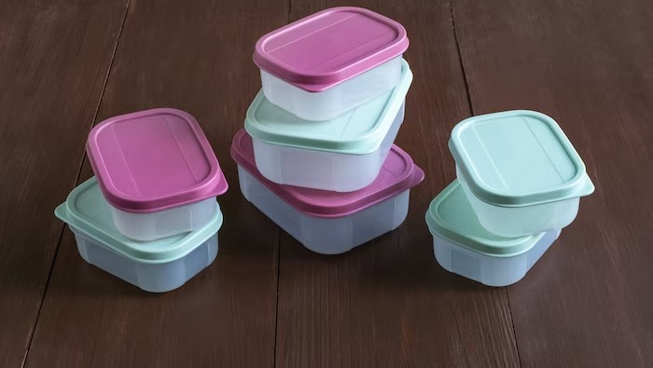
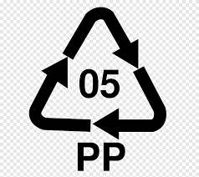
Type 5: PP (Polypropylene)
PP is used for yogurt cups, margarine tubs, and takeout containers. It has a high melting point, making it suitable for microwave use. PP is considered safe for food packaging and is recyclable. However, it may not be easily accepted by all recycling facilities.

Slide 8
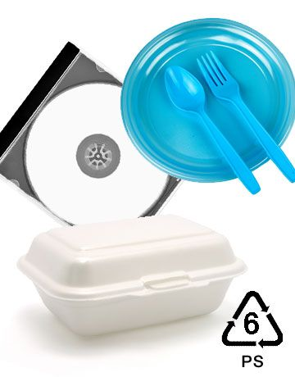
Type 6: PS (Polystyrene)
PS is used for foam food trays, disposable cups, and packaging peanuts. It is lightweight and has good insulation properties. However, PS can leach styrene, a potential carcinogen, into food. It is not recommended for food packaging, especially when in contact with hot liquids.

Slide 9
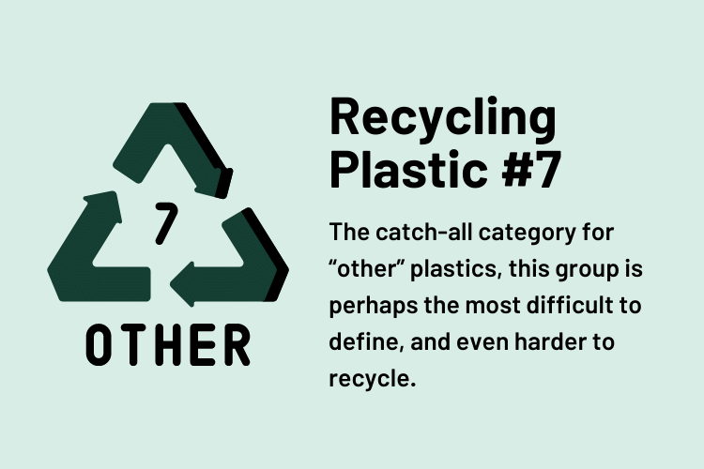
TYPE 7: OTHER PLASTICS
Type 7 includes various plastics like polycarbonate (PC) and bioplastics. PC is used for baby bottles and reusable water bottles. It may contain bisphenol A (BPA), which can mimic hormones in the body. Bioplastics are made from renewable sources but may require speciﬁc conditions for proper decomposition.

Slide 10
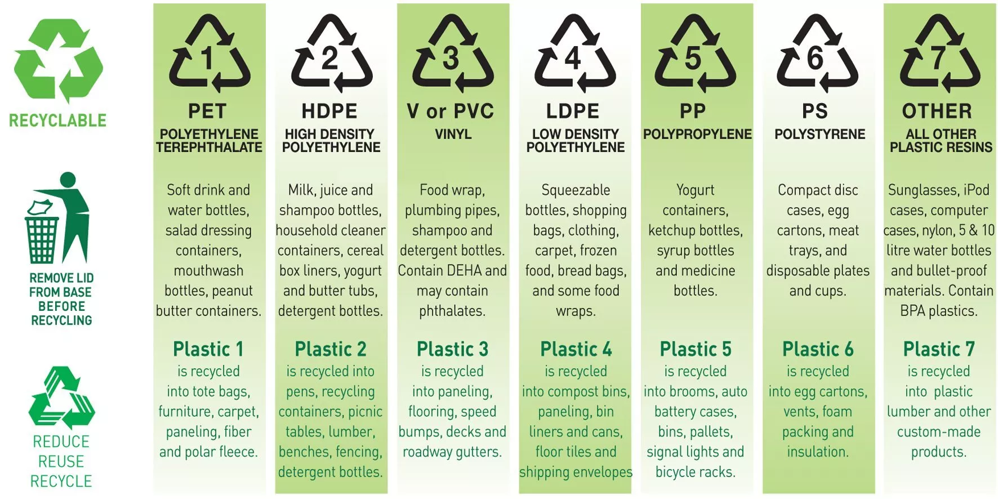

Slide 11
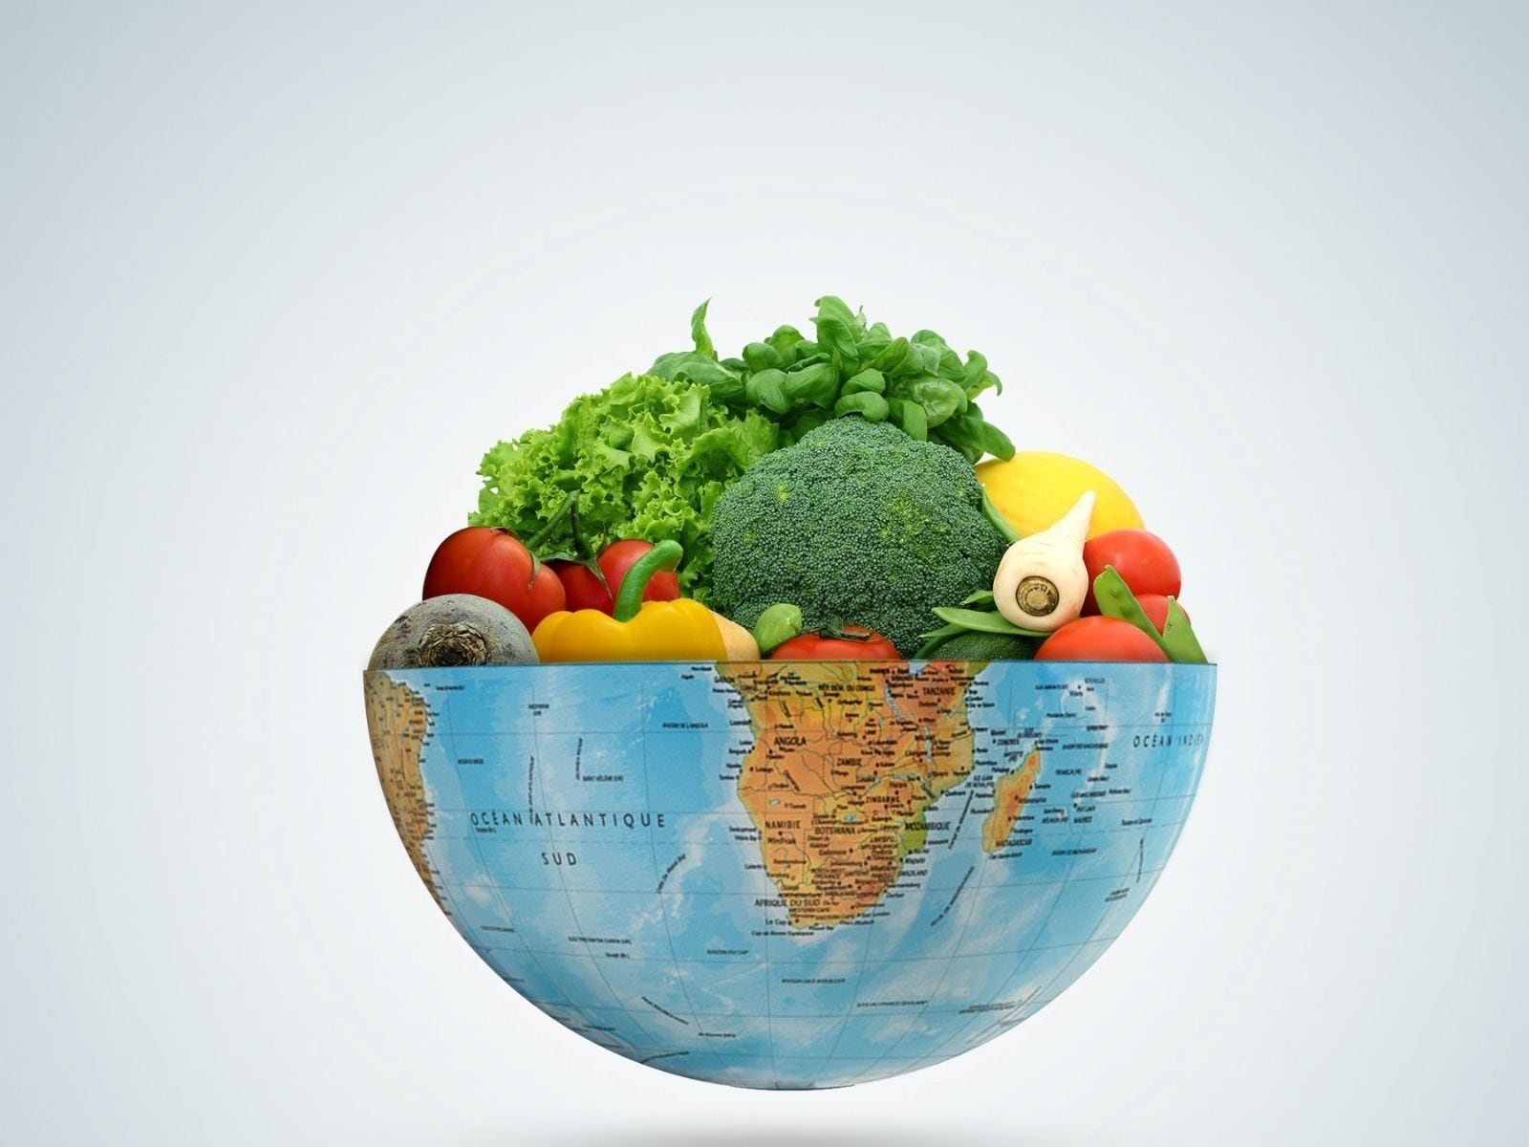
FOOD SAFETY CONCERNS
Plastics used in food packaging can pose food safety concerns due to chemical leaching. Migration of harmful substances like phthalates, styrene, and BPA into food can occur, especially when in contact with heat or acidic foods.
It is important to choose appropriate plastics for food packaging to minimize these risks.

Slide 12


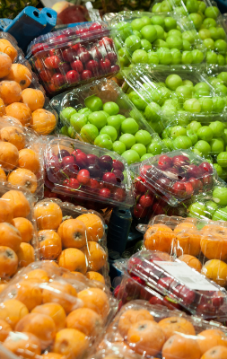

ENVIRONMENTAL IMPACT
Plastics in food packaging contribute to environmental pollution. Improper disposal and lack of recycling lead to plastic waste in landﬁlls and oceans. Some plastics take hundreds of years to decompose. It is crucial to promote recycling and explore sustainable alternatives to minimize the environmental impact.

Slide 13
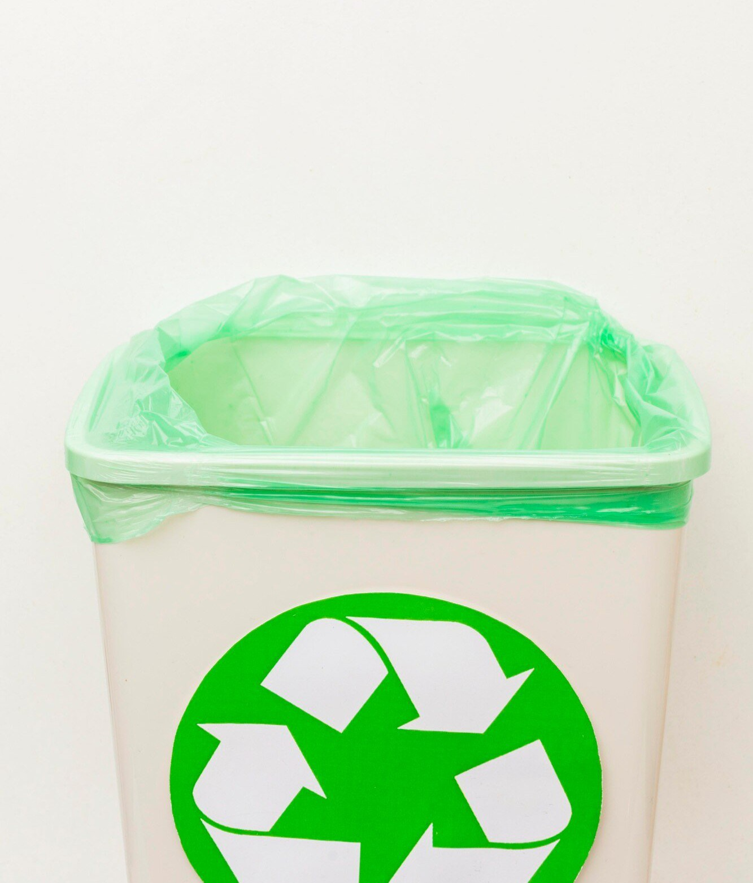
REGULATIONS AND LABELING
Regulations and labeling requirements vary across countries regarding the use of plastics in food packaging. It is important for manufacturers to comply with these regulations and provide clear labeling to inform consumers about the type of plastic used and any associated risks.

Slide 14
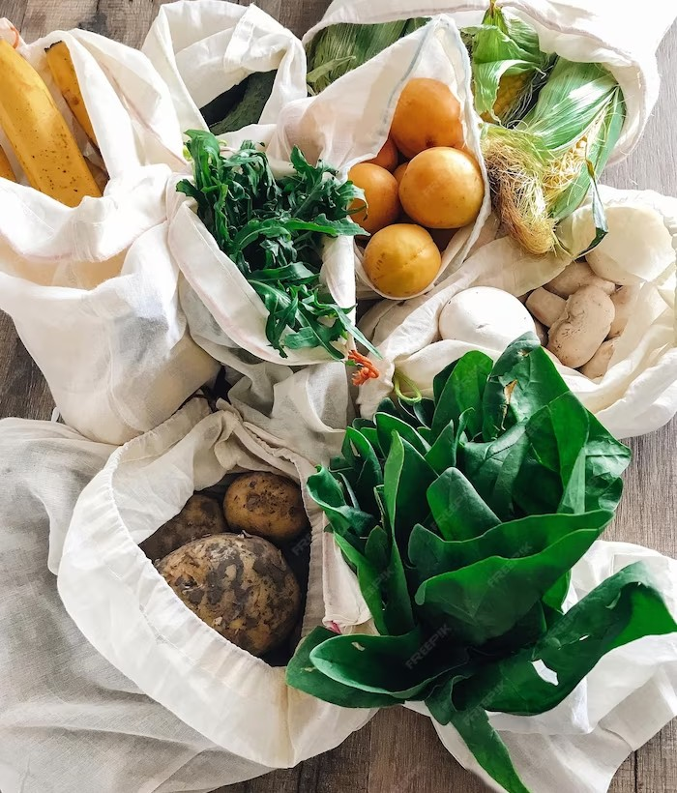
ALTERNATIVES TO PLASTIC
To mitigate the negative impact of plastics in food packaging, alternative materials and packaging solutions are being explored. These include biodegradable materials, compostable packaging, and reusable containers. Transitioning to these alternatives can help reduce plastic waste and promote a more sustainable food packaging industry.

Slide 15
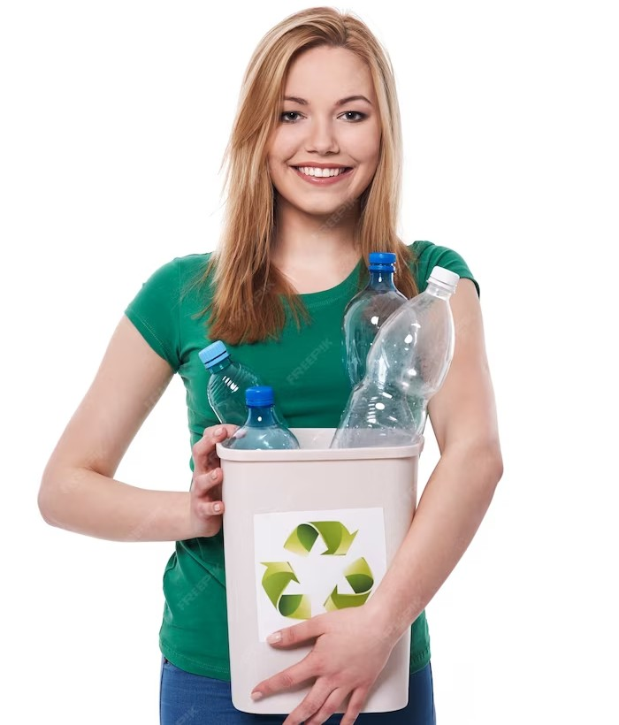
CONSUMER AWARENESS AND CHOICES
As consumers, being aware of the different types of plastics in food packaging empowers us to make informed choices. By opting for products packaged in safer and more sustainable materials, we can contribute to a healthier environment and encourage the industry to prioritize food safety and sustainability.

Slide 16
CONCLUSION
Understanding the 7 types of plastics in food packaging is essential for ensuring food safety and minimizing environmental impact. Each type of plastic has its own properties and associated risks.
By making informed choices and supporting sustainable alternatives, we can work towards a future with safer and more eco-friendly food packaging solutions.

Slide 17

Thanks!

